Slide 1
National Agency for the Valorization of Hydrocarbon Resources
«ALNAFT»
Oil and Gas E&P Opportunities
2018 US-ALGERIA ENERGY FORUM
Houston, January 29th 2018

Slide 2
Outlines
ALNAFT
Algeria
Hydrocarbons Mining Domain
Infrastructures
Opportunities
Done in 2017
Strategy
Conclusion

Slide 3
ALNAFT
A National Agency, created in 2005.
Main missions
Promote the offshore and onshore domains ;
Further develop Algerian O&G upstream by attracting investments;
The agency ensures a rational management of the oil & gas resources and a harmonious development.

Slide 4
ALNAFT
ALNAFT is in charge to:
Conclude research and / or exploitation contracts ;
Manage the Hydrocarbons Mining Domain
Manage the national E&P data bank;
Evaluate and approve development plans ;
Assist and support operators.

Slide 5
ALNAFT
Chairman
General Secretary
Contracts & Legal Affairs
Promotion & Valorization
E&P Data Bank
Hydrocarbons
Development & Exploitation
Natural Gas
Organization

Slide 6
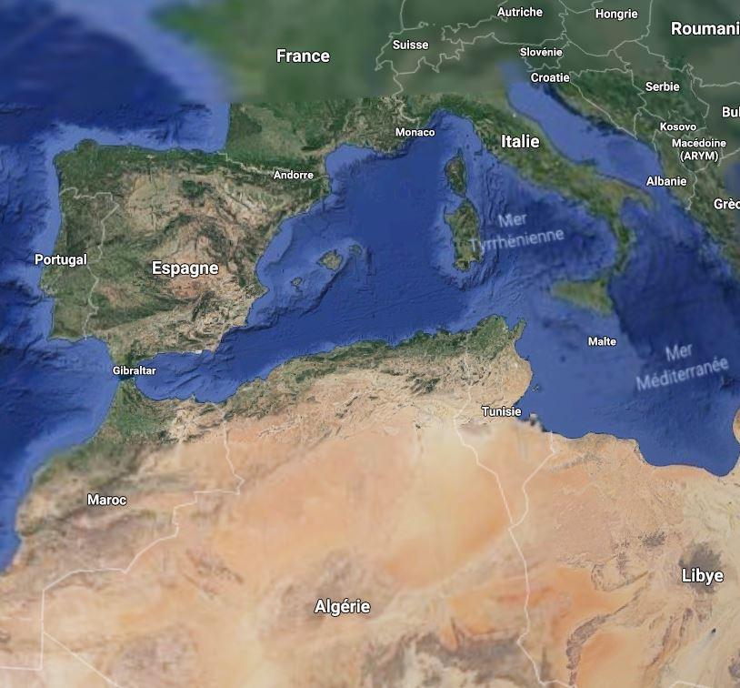
ALGERIA
Petroleum country ;
Population 40 millions;
Surface 2.380 MM km²;
Hydrocarbons Mining Domain:1.5 MM km²;
In front of and at one hour from Europe 500 Million consumers;
Coast 1200 km;
North to South, more than 2200 km.
ALGERIA

Slide 7
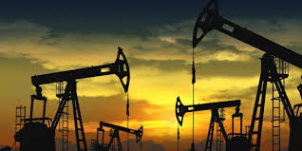
ALGERIA
Oil & gas
Production
1.2 MM bbls / day;
3.6 Tcf / year (+100 BCM / year).
Recoverable Reserves
Oil 10 Gbbls;
Gas 4200 BCM (150 Tcf).
Unconventional Resources
Liquids : 170 Gbbls, in place;
Gas : 6500 Tcf, in place.

Slide 8
hydrocarbonS mining domain

Slide 9
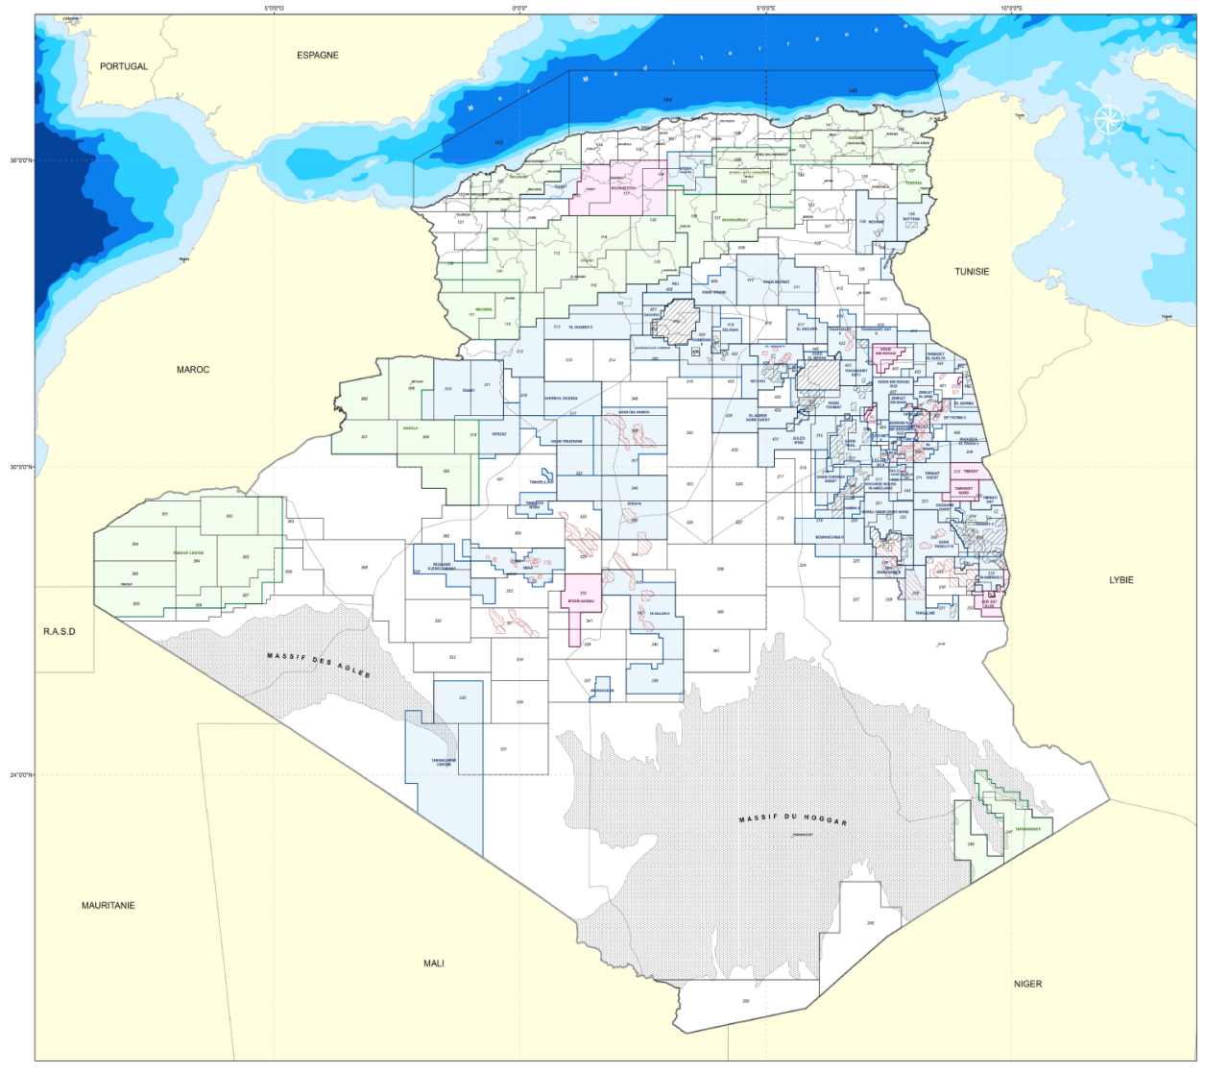
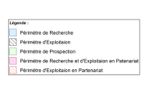
Hydrocarbons mining domain activities
Subdivided into 199 blocks
Oued Mya/HMD
Berkine/Illizi
Sonatrach operates
9 Prospecting Authorization
73 Research perimeters
122 Exploitation perimeters
Ahnet/
Timimoun
In partnership
49 Exploitation perimeters
7 Research perimeters
Activities :
Concentrated mainly in two regions (37 %);
63% remains Free.
Algerian blocks map

Slide 10
Hydrocarbons mining domain
Wildcat VS discoveries from 1986 to 2017

Slide 11
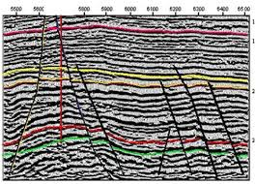
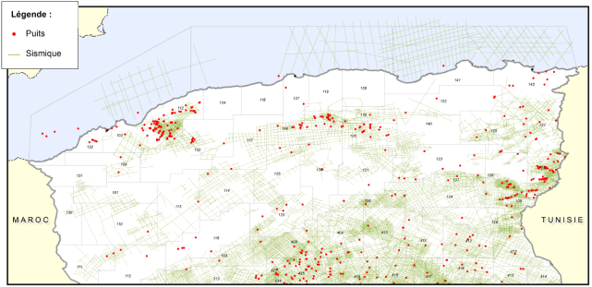
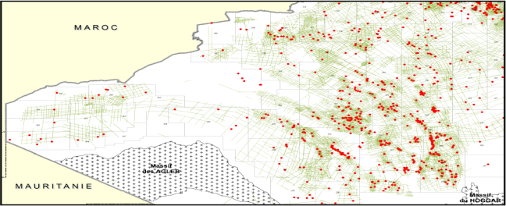
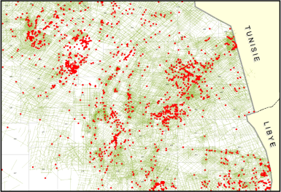
Hydrocarbons mining domain
E&P DATA
High quality , reliable and organized into an ISO 9001 V2015 Certified National Data Repository
Wide 3D/2D seismic coverage
Total of
670 000 Km 2D
180 000 Km² 3D
550 km of cores
> 10 000 Wells
Map of the seismic/well converage

Slide 12
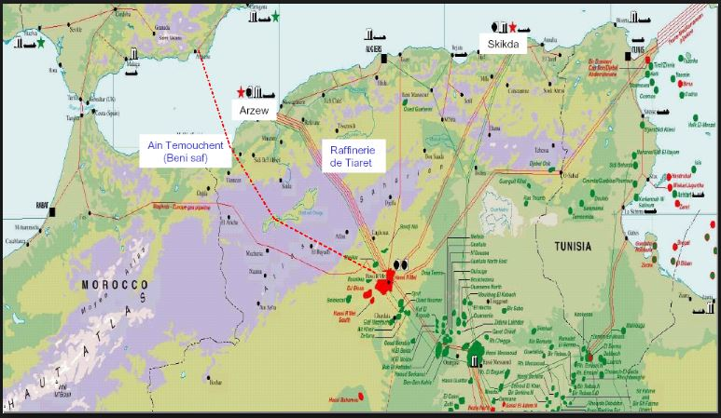
Infrastructures
20 855 km domestic pipelines,
3 pipelines connect Algeria to Europe 2 Tcf (54 BCM) / year;
88 Oil & Gas CPFs;
4 major natural gas liquefaction complexes: 56 BCM / year;

Slide 13
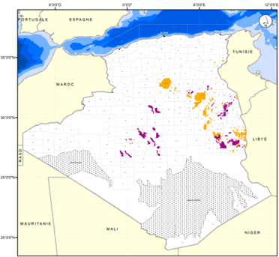
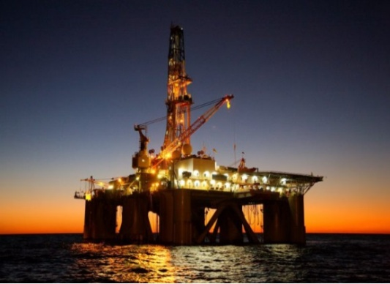
Opportunities
Six (6) opportunities domains
Prospection and Research in Frontier area;
Explore Deep horizon, Stratigraphic & mixed traps, in Mature basins;
Offshore;
EOR (mature fields): Enhancing Oil Recovery
RF from 30% to 40% = 6 Gbbls;
Shale and Tight sand formations;
Develop New discoveries
Last 10 years 270 Discoveries ;
2P in place 32 Tcf of Gas and 9 Gbbls of oil.
Studies to evaluate the potential of these opportunities

Slide 14
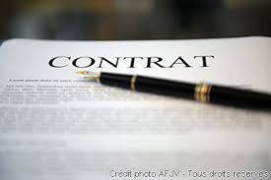
Done in 2017
Mainly
Extended 2 Exploitation PSC contracts with IOCs;
Signed 2 New Exploitation contracts with IOCs ;
Signed Six (6) R&E contracts with Sonatrach;
Launched 2 regional studies (Shale and North East of Algeria potentials);
Concluded 5 agreements with IOCs for studies (3 in offshore).

Slide 15
Strategy
The partnership is a strategic option.
We are focused on creating and maintaining mutually beneficial relationships with our partners. Through proactive collaborations with the different actors in the spirit of true partnership.
With a large unexplored potential, Algeria is open and welcoming investments in upstream activities to share all the opportunities.

Slide 16
Conclusion
Our objectives
Be a world-class Governmental agency;
Deliver a premium value to all oil and gas companies;
Meet the Algeria energy challenge.
Our mission
Build and sustain a world-class Agency through innovative partnerships.
Strong commitment to sustainable development and ethics.

Slide 17
THANK YOU and WELCOME TO ALGERIA
Guided by our values of integrity, innovation and investment we work hard to earn the high regard of our partners, investors and other major companies around the world.

